Slide 1
Computer Architecture
Chapter-3

Slide 2
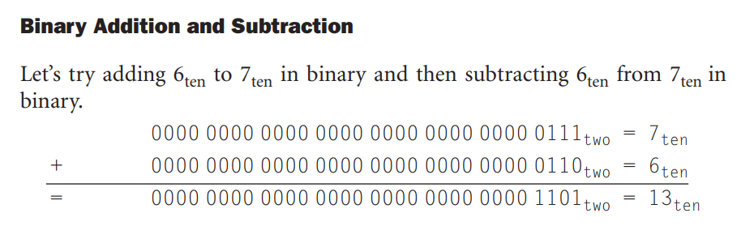
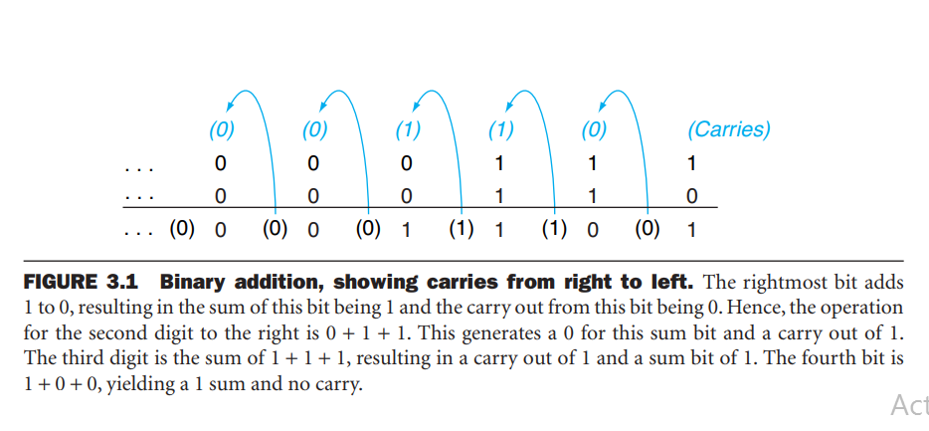
Addition & Subtraction

Slide 3
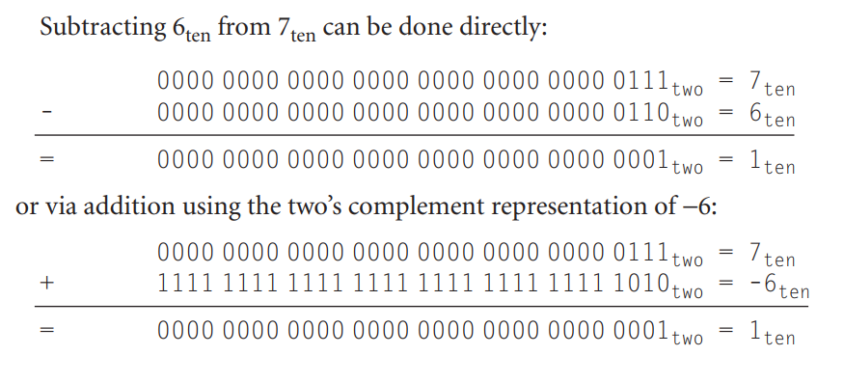

Slide 4
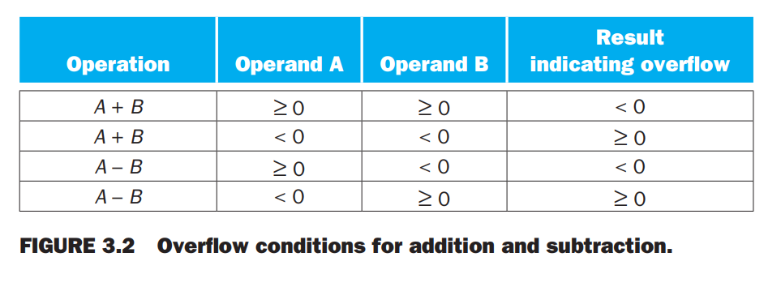
Overflow conditions for addition & subtraction

Slide 5
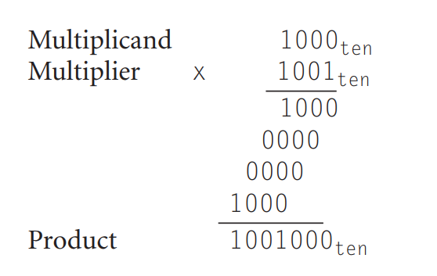
Multiplication

Slide 6
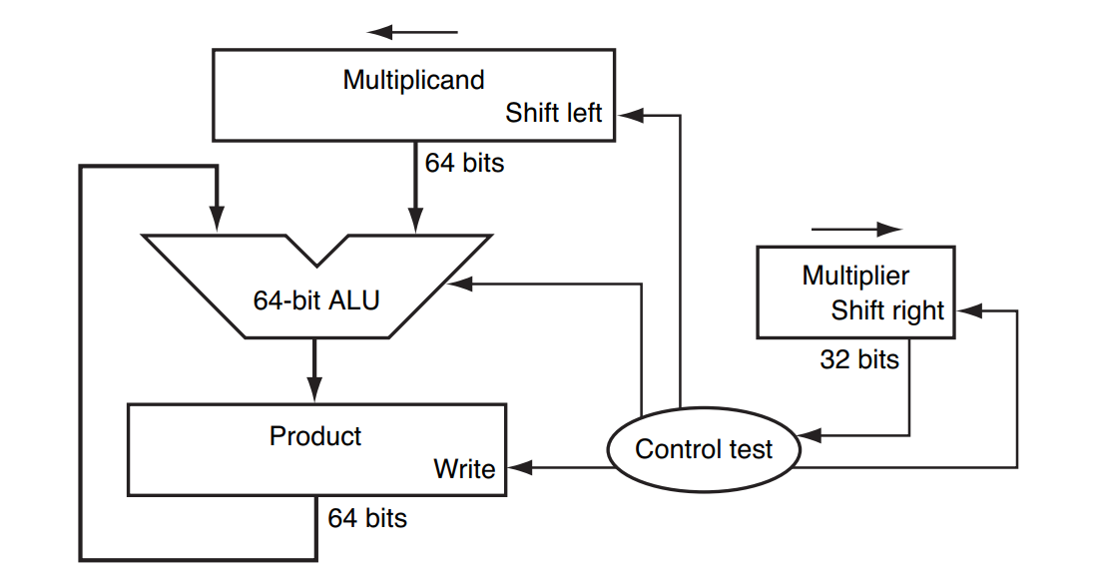
First Version of Multiplication Hardware

Slide 7
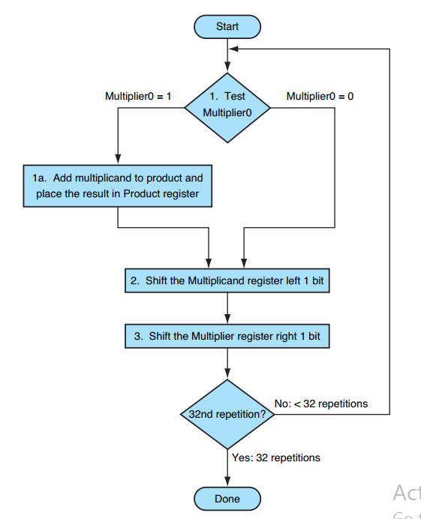
Flowchart (First Version of Multiplication)

Slide 8
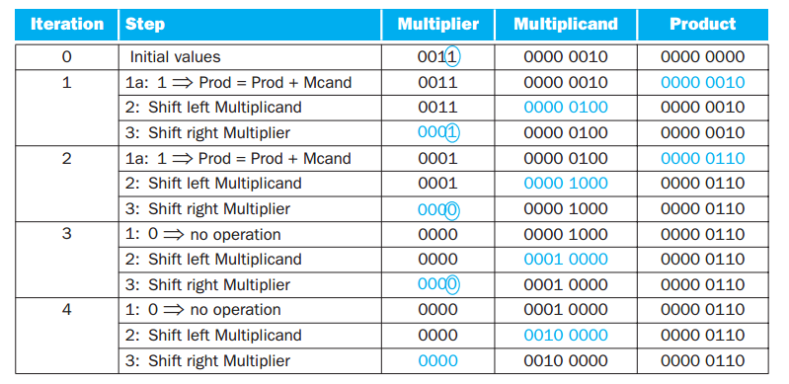

Slide 9
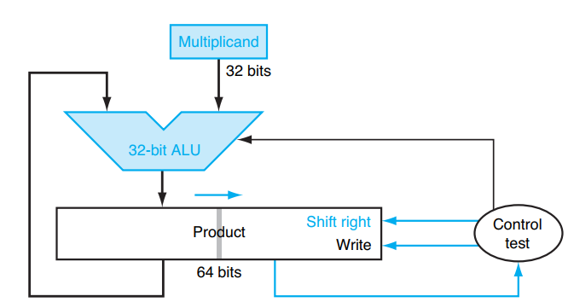
Refined Version of Multiplication Hardware

Slide 10
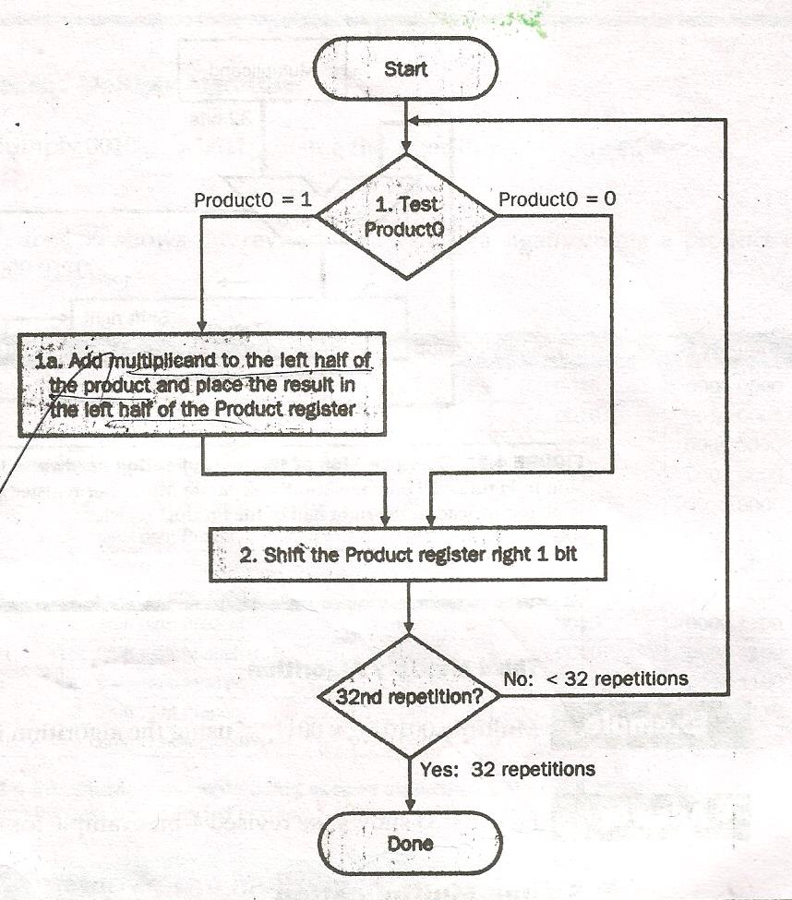
Refined Version of Multiplication Hardware

Slide 11
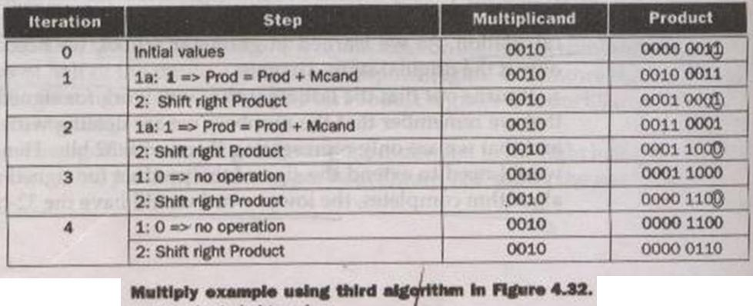
Refined Version of Multiplication Hardware

Slide 12
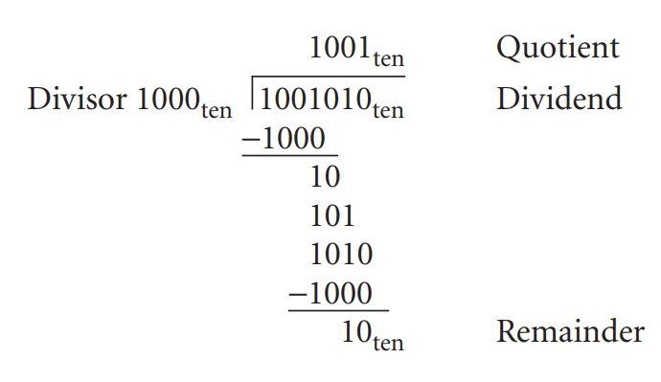
Division

Slide 13
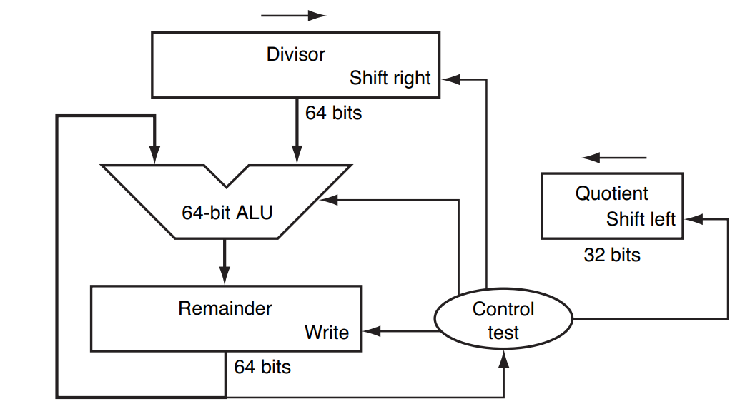
First Version of Division Hardware

Slide 14
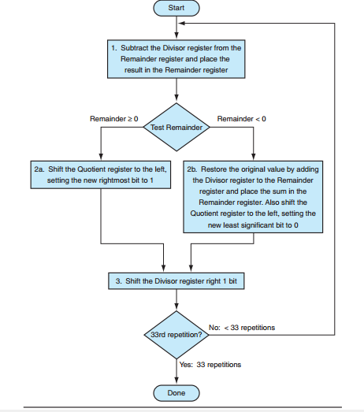
First Version of Division Flowchart

Slide 15
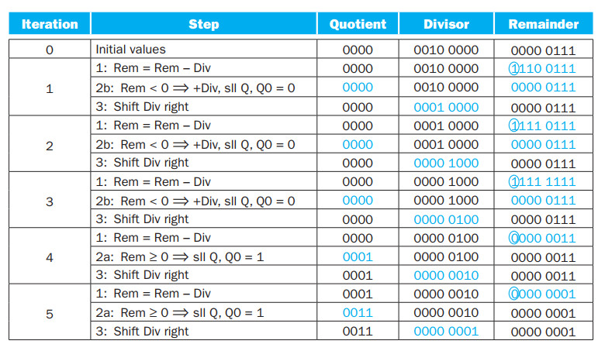
First Version of Division Example

Slide 16
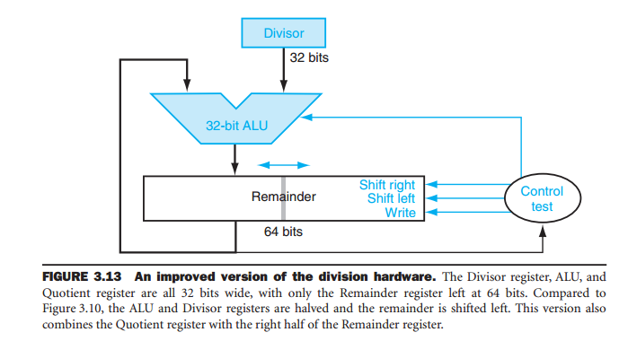
Final Version of Division Hardware

Slide 17
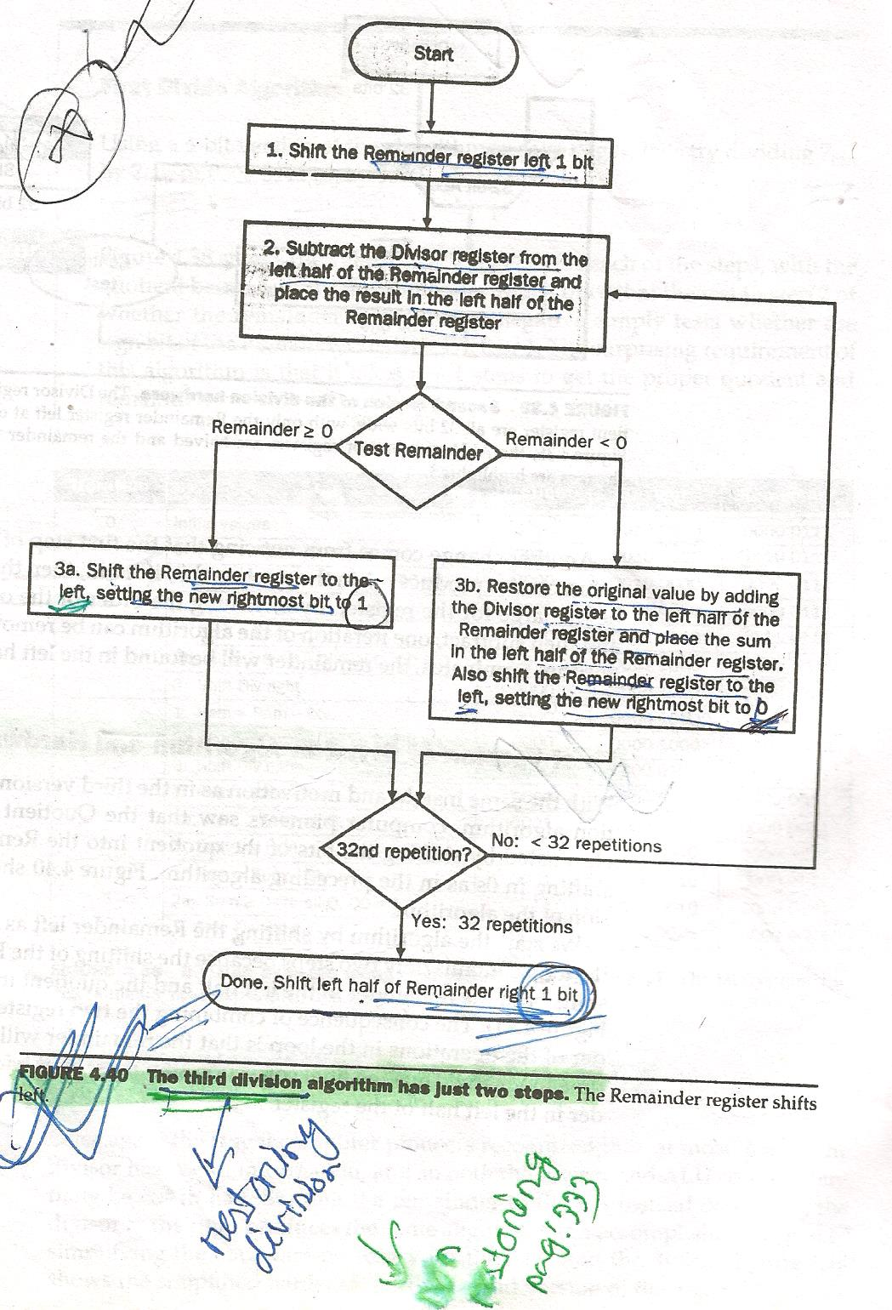
Final Version of Division Algorithm

Slide 18
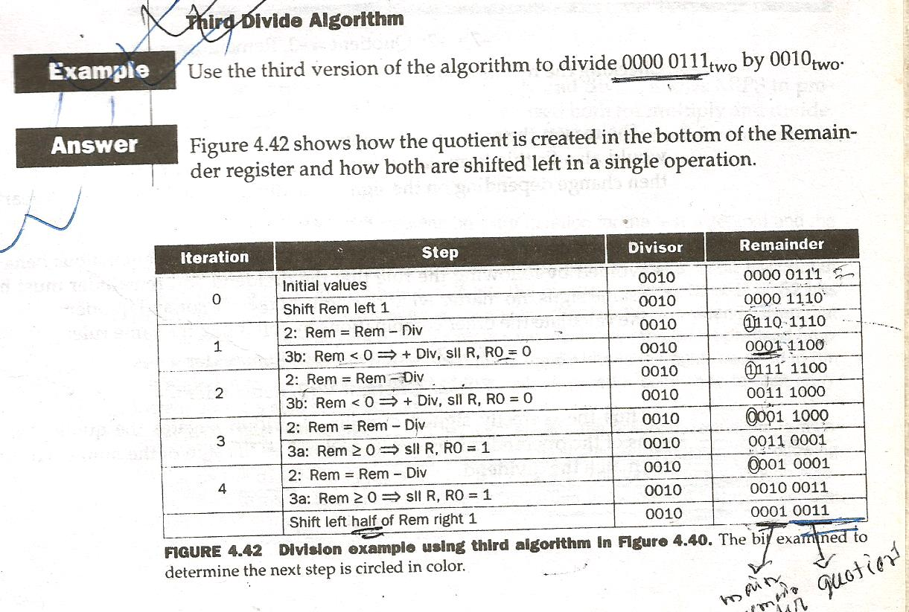
Final Version of Division Example

Slide 19
4.8 Floating Point
Real numbers:
3.14159265…. (π)
2.71828… (e)
0.000000001 or 1.0 × 10⁻⁹ (seconds in a nanosecond)
3,155,760,000 or 3.15576 × 10⁹ (seconds in a century)
Scientific Notation

Slide 20
4.8 Floating Point
Normalized numbers:
A number in scientific notation that has no leading zeros.
1.0 × 10⁻⁹
0.1 × 10⁻⁸
10.0 × 10⁻¹⁰
×

Slide 21
4.8 Floating Point
Binary numbers in scientific notation:
1.0 × 2⁻¹
1. xxxxxxxx × 2^{yyyy}
Computer arithmetic that support such numbers is called floating point because it represents numbers in which the binary point is not fixed.
Binary Point

Slide 22
4.8 Floating Point
A standard scientific notation for reals in normalized form offers three advantages:
It simplifies exchange of data that includes floating-point numbers
It simplifies the floating-point arithmetic algorithms to know that numbers will always be in this form
It increases the accuracy of the numbers that can be stored in a word

Slide 23
Floating Point Representation
Single precision
Sign and magnitude representation
(-1)^{S} × F × 2E
S – sign
F – significand
E – exponent
31 | 30 | 29 | 28 | 27 | 26 | 25 | 24 | 23 | 22 | 21 | 20 | 19 | 18 | 17 | 16 | 15 | 14 | 13 | 12 | 11 | 10 | 9 | 8 | 7 | 6 | 5 | 4 | 3 | 2 | 1 | 0
s | exponent |  |  |  |  |  |  |  | significand
1 bit
8 bits
23 bits

Slide 24
Floating Point Representation
Double precision
(-1)^{S} × (1 + Significand) × 2E
(-1)^{S} × (1 + (s1 × 2⁻¹) + (s2 × 2⁻²) + … … ) × 2E
IEEE 754
31 | 30 | 29 | 28 | 27 | 26 | 25 | 24 | 23 | 22 | 21 | 20 | 19 | 18 | 17 | 16 | 15 | 14 | 13 | 12 | 11 | 10 | 9 | 8 | 7 | 6 | 5 | 4 | 3 | 2 | 1 | 0
s | exponent |  |  |  |  |  |  |  |  |  |  | significand
1 bit
11 bits
20 bits
31 | 30 | 29 | 28 | 27 | 26 | 25 | 24 | 23 | 22 | 21 | 20 | 19 | 18 | 17 | 16 | 15 | 14 | 13 | 12 | 11 | 10 | 9 | 8 | 7 | 6 | 5 | 4 | 3 | 2 | 1 | 0
Significand (Continued)
32 bits

Slide 25
Floating Point Representation
When we want to represent zero (0)
(-1)^{S} × (1 + Significand) × 2E
(-1)^{S} × (1 + (s1 × 2⁻¹) + (s2 × 2⁻²) + … … ) × 2E
1 + 0 = 1
31 | 30 | 29 | 28 | 27 | 26 | 25 | 24 | 23 | 22 | 21 | 20 | 19 | 18 | 17 | 16 | 15 | 14 | 13 | 12 | 11 | 10 | 9 | 8 | 7 | 6 | 5 | 4 | 3 | 2 | 1 | 0
0 | 0 | 0 | 0 | 0 | 0 | 0 | 0 | 0 | 0 | 0 | 0 | 0 | 0 | 0 | 0 | 0 | 0 | 0 | 0 | 0 | 0 | 0 | 0 | 0 | 0 | 0 | 0 | 0 | 0 | 0 | 0

Slide 26
Floating Point Representation
Biased Notation
1.0 × 2⁻¹
1.0 × 2⁺¹
-1 → -1 + 127 = 126
+1 → +1 + 127 = 128
(-1)^{S} × (1 + Significand) × 2^{(Exponent – Bias)}
For Double Precision bias is 1023
31 | 30 | 29 | 28 | 27 | 26 | 25 | 24 | 23 | 22 | 21 | 20 | 19 | 18 | 17 | 16 | 15 | 14 | 13 | 12 | 11 | 10 | 9 | 8 | 7 | 6 | 5 | 4 | 3 | 2 | 1 | 0
0 | 0 | 1 | 1 | 1 | 1 | 1 | 1 | 0 | 0 | 0 | 0 | 0 | 0 | 0 | 0 | 0 | 0 | 0 | 0 | 0 | 0 | 0 | 0 | 0 | 0 | 0 | 0 | 0 | 0 | 0 | 0
31 | 30 | 29 | 28 | 27 | 26 | 25 | 24 | 23 | 22 | 21 | 20 | 19 | 18 | 17 | 16 | 15 | 14 | 13 | 12 | 11 | 10 | 9 | 8 | 7 | 6 | 5 | 4 | 3 | 2 | 1 | 0
0 | 1 | 0 | 0 | 0 | 0 | 0 | 0 | 0 | 0 | 0 | 0 | 0 | 0 | 0 | 0 | 0 | 0 | 0 | 0 | 0 | 0 | 0 | 0 | 0 | 0 | 0 | 0 | 0 | 0 | 0 | 0

Slide 27
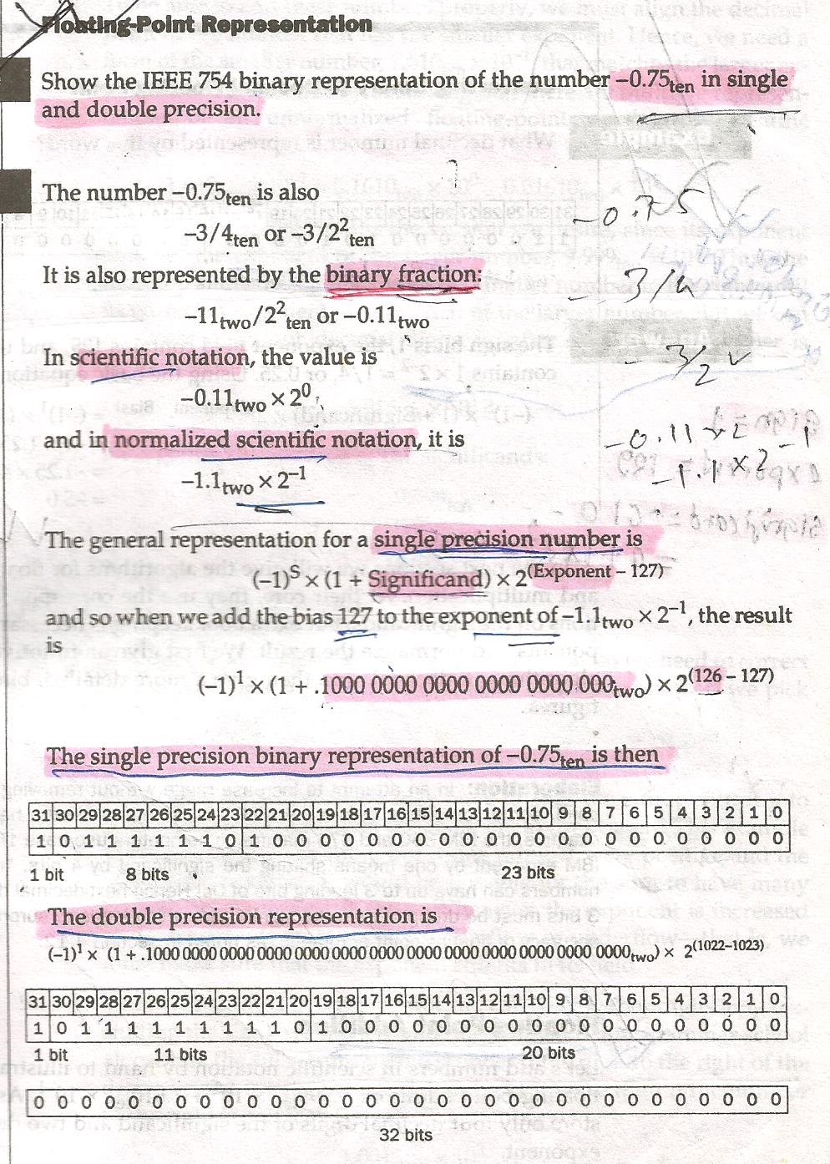

Slide 28
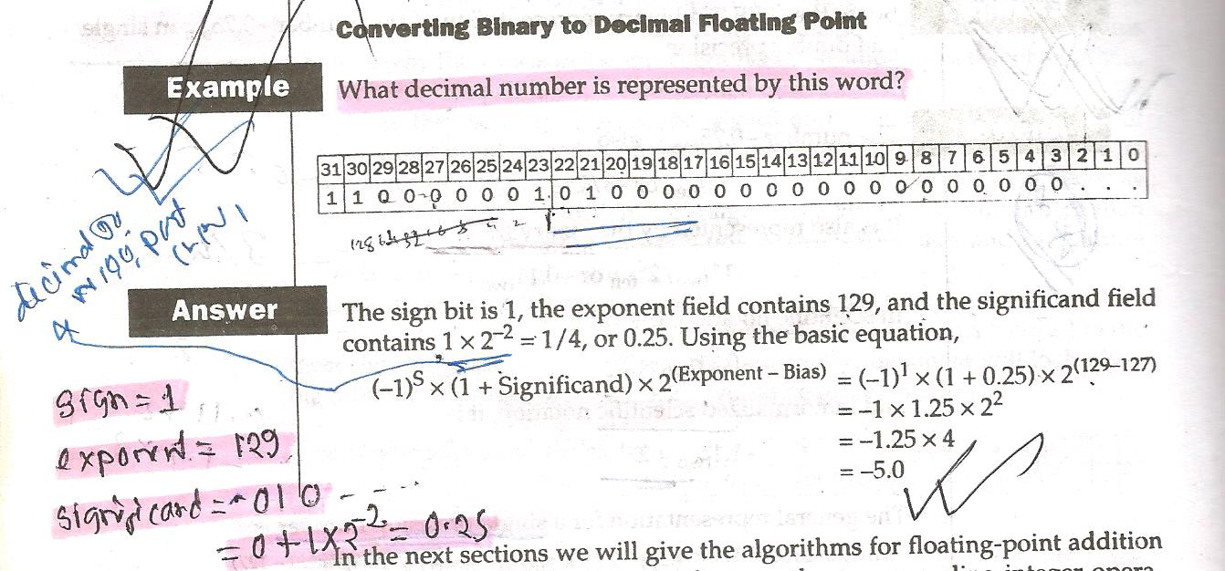

Slide 29
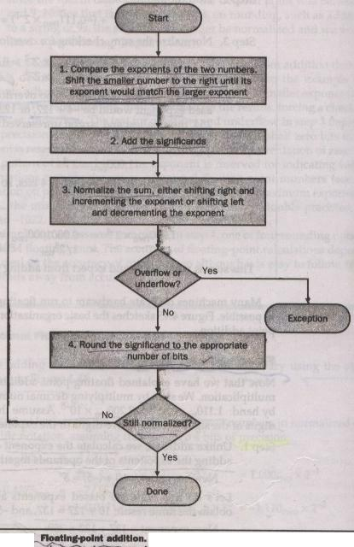
Floating Point Addition

Slide 30
Floating Point Addition
9.999 × 10¹ + 1.610 × 10⁻¹
Step 1: (Change the smaller number)
1.610 × 10⁻¹ = 0.1610 × 10⁰ = 0.01610 × 10¹
Step 2: (Addition of the significands)
9.999
+ 0.016
10.015
10.015 × 10¹

Slide 31
Floating Point Addition
10.015 × 10¹
Step 3: (Find the normalized form)
10.015 × 10¹ = 1.0015 × 10²
Check for overflow and underflow
Step 4: (Round the number)
1.0015 × 10² = 1.002 × 10²
Normalize again if required

Slide 32

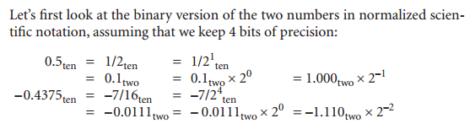

Slide 33
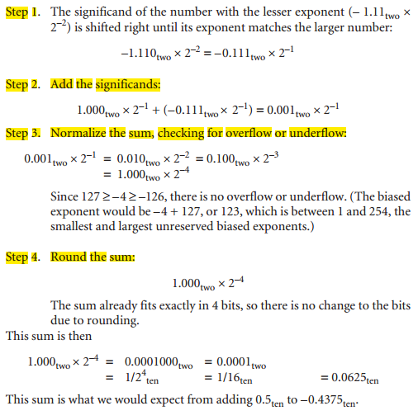

Slide 34
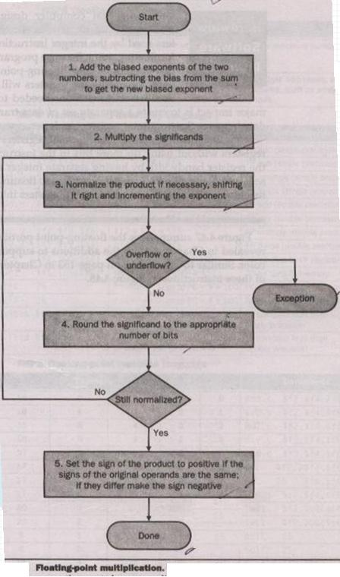
Floating Point Multiplication

Slide 35
Floating Point Multiplication
(1.110 × 10¹⁰) × (9.200 × 10⁻⁵)
Step 1: (Find the exponent of the product)
New exponent = 10 + (-5) = 5
Considering bias
New exponent = (10 + 127) + (-5 + 127)
= 137 +122 = 259 ×
New exponent = 137 + 122 -127
= 132 √

Slide 36
Floating Point Multiplication
(1.110 × 10¹⁰) × (9.200 × 10⁻⁵)
New exponent = 5 or 132
Step 2: (Multiplication of the significands)
1.110
× 9.200
0000
0000
2220
9990
10212000
10.212000 × 10⁵ = 10.212 × 10⁵

Slide 37
Floating Point Multiplication
(1.110 × 10¹⁰) × (9.200 × 10⁻⁵)
New exponent = 5 or 132
New product = 10.212 × 10⁵
Step 3: (Normalize the product)
10.212 × 10⁵ = 1.0212 × 10⁶
Check for overflow and underflow
Step 4: (Round the number)
1.0212 × 10⁶ = 1.021 × 10⁶

Slide 38
Floating Point Multiplication
(1.110 × 10¹⁰) × (9.200 × 10⁻⁵)
New product = 1.021 × 10⁶
Step 5: (Put the sign of the product)
+1.0212 × 10⁶

Slide 39

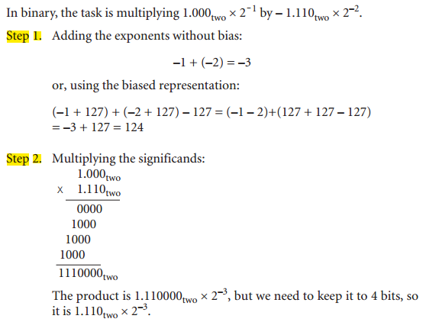

Slide 40
